Slide 1
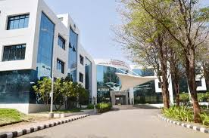
My College Memories: A JourneytoRemember
College is a transformative experience, filled with exciting new beginnings and enduring friendships. It's a time of academic challenges, personal growth, and unforgettable moments that shape us into the individuals we become.

Slide 2
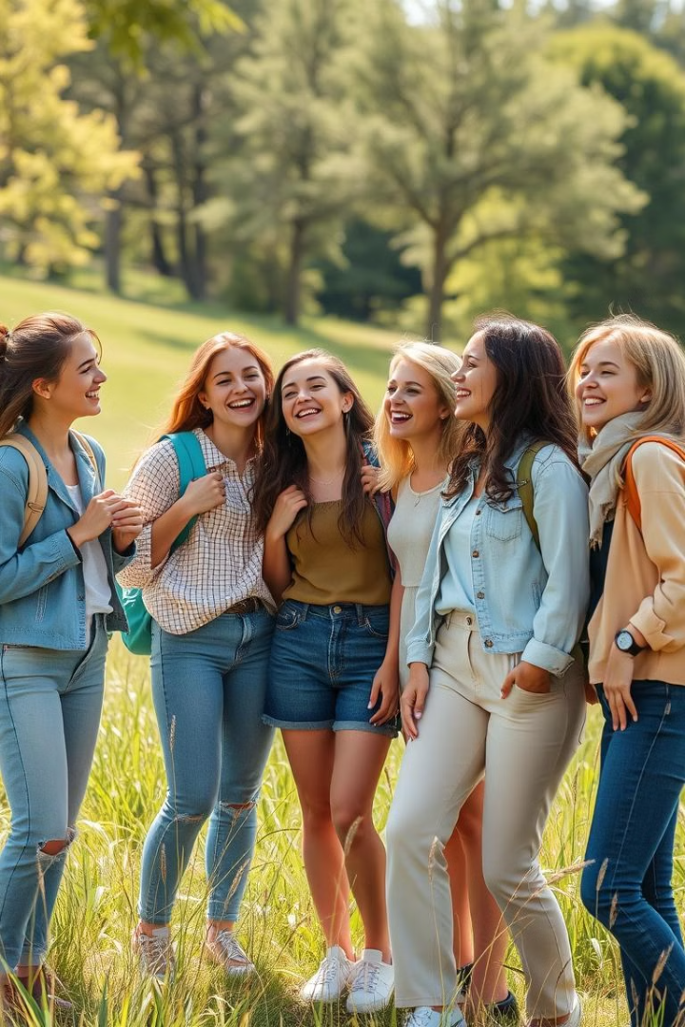
Building Friendships: Lifelong Connections
1
Daily gossips
2
Study Groups and
professor interactions
Forming close bonds with roommates, sharing late-night conversations, and creating unforgettable memories in the dorm.
Collaborating on assignments, brainstorming ideas, and supporting each other through academic challenges.
3
Social Events participation
Attending campus events, concerts, and sporting events, creating lasting memories with friends, and enjoying college life.

Slide 3

Four Years: The Excitement campus Life
1
Hostel life and campus life
The thrill of moving into a dorm room, unpacking boxes, and decorating a new space with posters and personal touches.
2
Academic exams
attending orientation sessions,and sessional exams.
3
Trips
Industrial visits nrsc center and goa waste management system

Slide 4

Graduation: The Bittersweet Farewell
Pride
completed the journey and achieved a milestone.
Nostalgia
Reflecting on the memories and friendships.
Excitement
embarking on new chapters, and pursuing dreams like get placed into good mnc’s.

